Slide 1
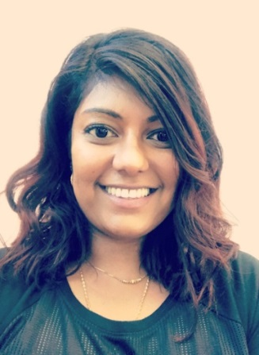
Herne Hill Group Practice
Summer 2018 Newsletter
Practice Pharmacist
Hi everyone! My name is Kirsty and I am currently the pharmacist based at Herne Hill Group Practice – although I haven’t met all of you I am almost certain I’ll have prescribed something for you at some point!
My role here involves anything and everything to do with medicine – from acute medication requests, repeat prescription reviews, ensuring treatment alterations are updated after a stay in hospital, assessing blood results for drug monitoring, liaising with local chemists’ right through to patient education and general medicine advice.
As I am able to prescribe independently I can also manage the care for people with self-limiting illnesses and those with long term conditions.
Ultimately my aim is to ensure that every patients medical treatment is optimised and effective, that patients know why they are taking their medicines and that they are happy with the medications they are taking thereby ensuring better health outcomes for all.
I have both face to face and telephone appointments available every day so if you have any concerns, queries or issues with anything to do with your medication then please book with me so we can sort things out as promptly as possible.
Lastly you may be asked by the team to attend for a medication review. This is not supposed to be an inconvenience but is something we have to do on an annual basis to ensure we are being accountable and looking after you properly. Sometimes this is able to take place on the telephone and is very quick, other times it involves completing a physical assessment and needs a face to face discussion. We will do our best to accommodate your needs whilst ensuring that we are prescribing both safely and effectively.
Welcome Dr Katija Ali
Dr Katija Ali BSc, MBBS, DRCOG, MRCGP.
I am delighted with my new post here at Herne Hill Group
Practice and look forward to meeting you all.
I have completed the diploma in Women’s Health and
currently I'm doing a masters in Sports Medicine,
Health & Exercise...Hoping to keep the population of
South London healthy!

Slide 2
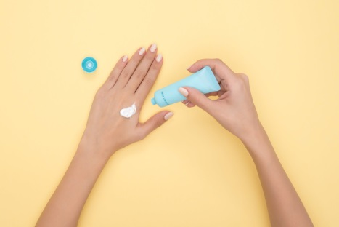
ENJOY THE SUN SAFELY THIS SUMMER
Summer is here and we all cannot wait to get out into the sunshine. We all know that we need the sun for healthy bones by making vitamin D. However, we must remember that too much sun can damage the skin causing it to age as well as giving rise to skin cancers.
Here are some tips to help you enjoy the sun safely:
Always wear sunscreen of SPF ( sunscreen factor) 15 or greater
Re-apply sunscreen at least every 2 hours, more frequently if swimming
Cover up with a sunhat, long sleeved t-shirts and sunglasses
Avoid being in direct sunlight when the sun is at its hottest- between 11 and 3 stay under the trees!
Drink plenty of water whilst you are out
Have fun!
~ Dr Denise Robertson
Patient Participation Group (PPG) open general meeting
The HHGP PPG is holding an open meeting on Tuesday 17th July, 18:30 to 20:00 welcoming all patients from the practice. The PPG was formed in September 2016 and consists of a steering group of around 10 patients whose aim is to ensure that the concerns and views of the patients are heard by the practice.
The PPG has achieved a number of successes since its inauguration and this meeting is a great opportunity to find out what the group has been doing over the past year as well as the upcoming activities it has planned including areas where patients have made a real difference.
The steering group of the PPG is always very keen to hear from patients and those who are interested in becoming a member. If you would like to meet the current members and understand more about what the PPG does, drop by between 18:30 and 20:00on 17th July for refreshments and friendly discussions with the group.
Self care is about looking after yourself in a healthy way. This can be from eating properly, doing some exercise to managing common conditions (minor ailments) like headaches and colds.
Last year in Lambeth the NHS spent over £1 MILLION on products to treat these common conditions that can be bought over the counter without a prescription.
We have therefore been advised to stop providing certain medicines on prescription on a routine basis (sometimes there are exceptions to this rule). Medicines such as paracetamol, ibuprofen gel, hayfever treatment, ear wax remover, eye drops for dry eyes, vitamins and minerals are all on the list of those medications which patients should purchase themselves.
For advice and information on how to self care and treat a range of common conditions visit www.lambethccg.nhs.uk or pick up a Self care leaflet from the surgery.

